Slide 1

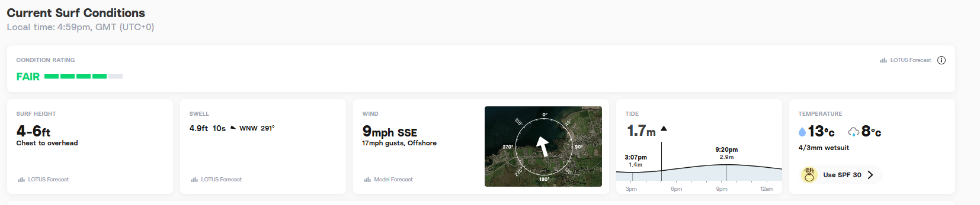
INDEX PAGE
Home
Brands
Lessons
About
Contact
*image from Giphy
*from Surfline – create API in bootstrap

Slide 2
BRANDS PAGE
Home
Brands
Lessons
About
Contact
Stock / brands we sell

Slide 3

LESSONS PAGE - ROSIE
LOGO
COMPANY NAME
HOME
BRANDS
LESSONS
ABOUT
CONTACT
SINGLE TEXT LINE
TEXT TEXT TEXT TEXT TEXT TEXT TEXT TEXT TEXT TEXT
TEXT
TEXT
TEXT
TEXT TEXT TEXT TEXT TEXT TEXT TEXT TEXT TEXT TEXT
TEXT
TEXT
TEXT
TEXT TEXT TEXT

Slide 4
ABOUT PAGE - ROSIE
Home
Brands
Lessons
About
Contact

Slide 5
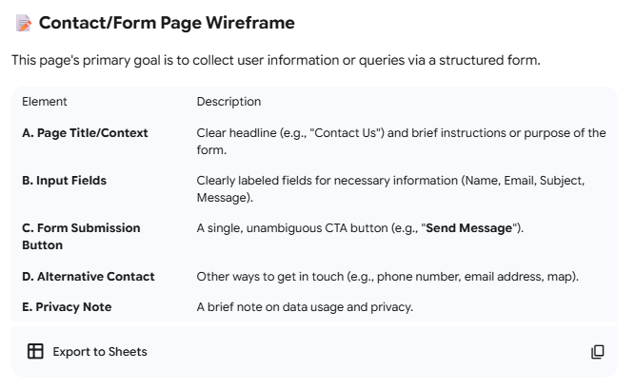
CONTACTS PAGE
Home
Brands
Lessons
About
Contact
Location: Lahinch, Co. Clare
Contact form
Include google map (active element)

Slide 6
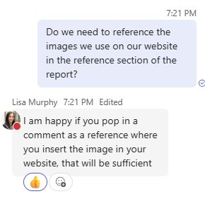

LOGO DESIGNS
GoogleGemini (2025) A logo for a surf shop using #fc9c60 and #307fc9 colour codes [AI-generated image]. (Accessed: 27 October 2025)
OCEAN RIDERS
SURF SHOP
Home
Brands
Lessons
About
Contact
Home
Brands
Lessons
About
Contact

Slide 7
COLOUR CODES
Greys
#f2f2f2
#d9d9d9
#c4c4c4
#a1a1a1
#787878
#525252
Oranges
#fc9c60
#ffbc70
#e48e41
Blues
#307fc9
#1f4c75

